Slide 1
Remote Repository
(GitHub)

Slide 2
Table of Contents
Remote Repository (GitHub)
Cloning a Remote Repository
Remote Repo Operations

Slide 3
Recap- Git Workflow
1

Slide 4
Recap-Basic Commands
git init
git status
git add .
git rm --cached
git commit -m “abc”
git log
git checkout commitID
Local Machine
GitHub
Working directory
Staging area (index)
Git repository
Remote Git repository
git add
git commit
git checkout

Slide 5

Recap-Branches
git branch branch_name
git branch
git branch -r
git branch -a
git checkout branch_name
git checkout -b branch_name
git branch -d branch_name
git branch -D branch_name
git merge branch_name

Slide 6
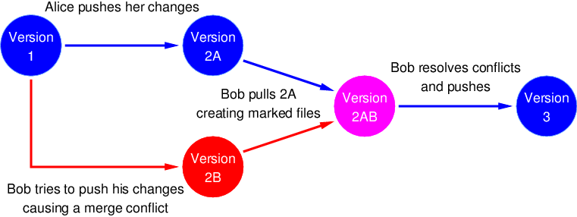
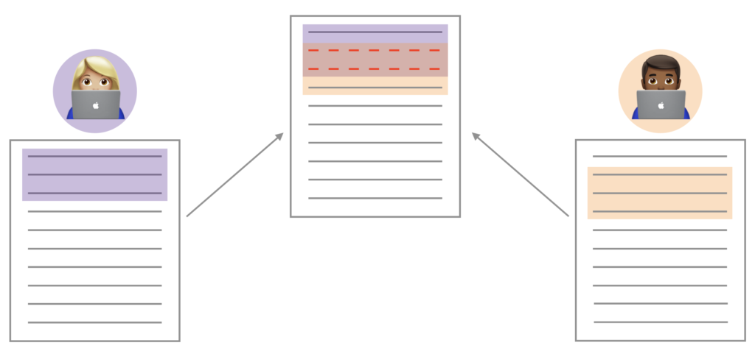
Merge Conflicts
Merge conflicts happen when you merge branches that have competing commits, and Git needs your help to decide which changes to incorporate in the final merge.
Same files were edited in both branches

Slide 7
Remote Repository (GitHub)
2

Slide 8


Github - Remote Repository
Git
GitHub
&
Distributed
version-control system
Repository hosting service

Slide 9
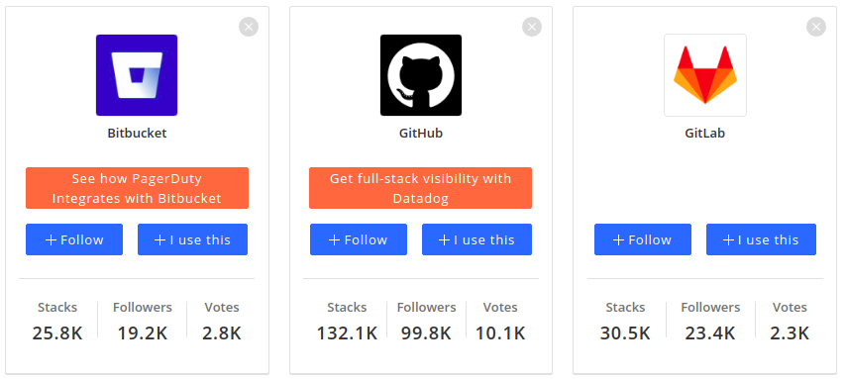
Github - Remote Repository

Slide 10
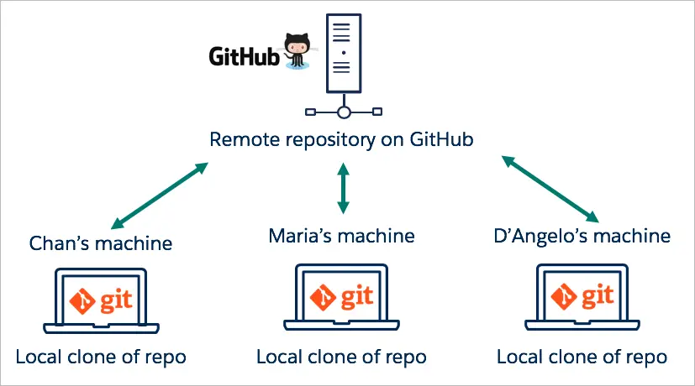
Github - Remote Repository
(default name - origin)

Slide 11
Github - Remote Repository
Act of copying a repository from remote server to your local machine is called cloning
Cloning allows team to work together
Downloading commits from others : fetch, merge
Downloading commits from others : pull (fetch + merge)
Uploading your commits (local changes) to remote : push
Notes:
Let’s start with cloning.
Let’s create a new repo and put a new file on it. Do our first commit.
mkdir gitprojects
499 cd gitprojects/
500 git clone https://github.com/clarusway/labb.git
501 ls
502 git ls
503 ls
504 cd labb
505 ls
506 vim file2.txt
507 git status
508 git add .
509 git commit -m "mee"
510 git s
511 git push origin master
Secondly give them the link of your code and show fork. change it.
Then show them to clone again. remote to remote and then clone.
Scenario: git clone, change the file on remote, git status, git fetch, git merge
then do the same thing with git pull.
change 1 file and try to push before pull see the problem. git pull
Visual representation
Create a commit and push
create a branch and push
local: merge the branch
push
git commit
git commit
git push origin master
git pull
Fetched 0 commits on master.
Already up-to-date.
git fetch
Fetched 0 commits on master.
git branch eric
git push
Everything up-to-date.
git checkout eric
git commit
git commit
git push origin eric
git checkout master
git merge eric
You have performed a fast-forward merge.
git push origin master
Remote visual representation:
git push origin master
Push rejected. Non fast-forward. Try pulling first
git pull
Fetched 0 commits on master.
Fetched 1 commits on feature.
Fast-forwarded to origin/feature.
git commit
git commit
git push origin feature
git checkout master
git merge feature
git push

Slide 12
Connecting your local with remote
connect to remote repo
git remote add origin Repo address
git remote -vt
origin = alias for your repo address
first push
git push -u origin master t
remove remote origin
git remote rm origin t
Notes:
Everybody has a Github account right?
Origin is an alias to the remote repository. We say origin so we won't have to write out the URL of the remote repo every time in the future. While origin is the name most people use, you can name it something else.
-u is short for --set-upstream and adds an upstream (tracking) reference so in the future, Git will remember where we want to push to and pull from. That will allow us to use git pull or git push without having to specify extra arguments.
If this is the first time pushing to the remote server, you should be asked to login with your username and password.

Slide 13
Github - Remote Repository
Working directory
Staging area (index)
Git repository
Remote Git repository
git add
git commit
git push
git checkout
git fetch
git pull
Notes:
Let’s start with cloning.
Let’s create a new repo and put a new file on it. Do our first commit.
mkdir gitprojects
499 cd gitprojects/
500 git clone https://github.com/clarusway/labb.git
501 ls
502 git ls
503 ls
504 cd labb
505 ls
506 vim file2.txt
507 git status
508 git add .
509 git commit -m "mee"
510 git s
511 git push origin master
Secondly give them the link of your code and show fork. change it.
Then show them to clone again. remote to remote and then clone.
Scenario: git clone, change the file on remote, git status, git fetch, git merge
then do the same thing with git pull.
change 1 file and try to push before pull see the problem. git pull
Visual representation
Create a commit and push
create a branch and push
local: merge the branch
push
git commit
git commit
git push origin master
git pull
Fetched 0 commits on master.
Already up-to-date.
git fetch
Fetched 0 commits on master.
git branch eric
git push
Everything up-to-date.
git checkout eric
git commit
git commit
git push origin eric
git checkout master
git merge eric
You have performed a fast-forward merge.
git push origin master
Remote visual representation:
git push origin master
Push rejected. Non fast-forward. Try pulling first
git pull
Fetched 0 commits on master.
Fetched 1 commits on feature.
Fast-forwarded to origin/feature.
git commit
git commit
git push origin feature
git checkout master
git merge feature
git push

Slide 14
Git Basics
Summary
Notes:
The third category of person to speak about when discussing an implementation of Git is the person who will use it for a long time, find all the deep crevices and features of it, and in fact want to stretch it to its absolute maximum.
That person is also served well by Git. Even though it's very easy for the introductory person, it's also very capable for the advanced individual.
You can find that through its Unix-like structure, the ability to glue together these small programs and use option switches to control the behavior, that it suits the needs of an advanced version control user extremely well.

Slide 15
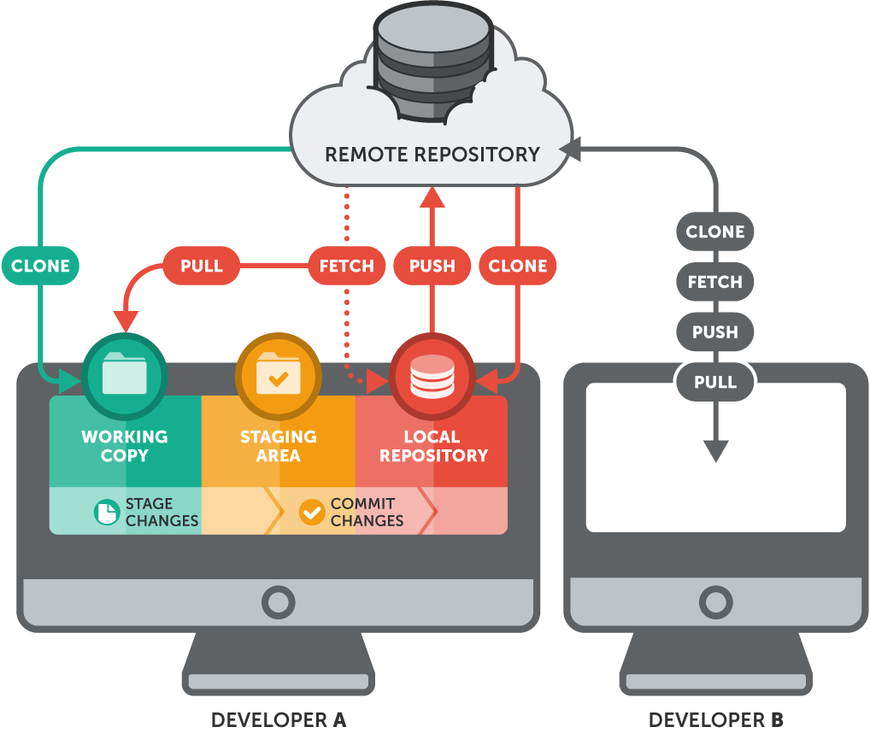
Git Basics
GitHub

Slide 16
THANKS!
Any questions?
You can find me at:
martin_fade@clarusway.com
tyler@clarusway.com

